Slide 1

Notes:
For more info, please contact Matt Philip (@mattphilip, matthewrphilip@gmail.com)

Slide 2

Big Picture
Objective: Learn what and how much different factors influence delivery time and understand options for forecasting
Complete work cards to deliver the most value!
Play in “day” rounds
Teams play independently but have interdependency with other teams

Slide 3
The Work
Cards depict the work needed
Backlog = 25 cards
Average effort per card = 21
Work must be completed sequentially
Some cards are urgent!
Some have a dependency on another team

Slide 4

The People
Each person can do 4 points of effort per day. Use cubes to keep track.
People can work in areas outside their specialty, but they get only half the points.
If you work on more than one team in a day, you lose one point per extra team (context-switching penalty).

Slide 5
Staff Your Teams!
Divide into teams of 4-7 people – they do not all have to be same size
Decide as a group each player’s role (wear a “role” name tag)

Slide 6
Team Dependency
Some cards have a dependency on another team.
When you start a card that has one, draw a team card to see which team it is dependent upon.
To complete the card, someone from that team must spend time helping you. (Time spent helping another team counts against that person’s capacity.)

Slide 7
Blockers
For each card in progress at the end of the day, roll the die.
If you roll 1, the card is blocked. Place a blocker sticky on the card.
At the beginning of the next day, roll the die for each blocked card. 1, 2 or 3 = still blocked (no work can be done on it that day) 4, 5 or 6 = unblocked (remove the sticky, continue work)

Slide 8
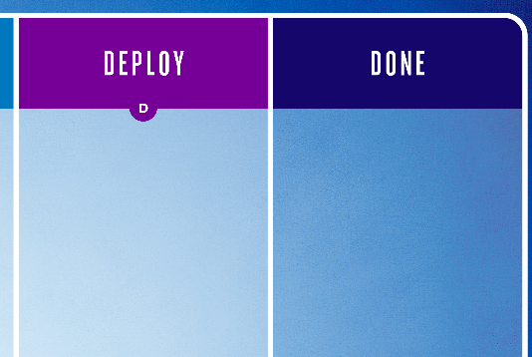
Deployment
For each card whose deployment work is complete, roll the die at the end of the day.
If you roll 1, the card requires rework. Move the card back to Deployment and redo the Deployment work.

Slide 9
Daily Actions
Decide how to use each person’s effort for the day
Pull in as many cards as you want and record the day for commit date
Roll to resolve any blocked cards
Tick off work on the cards and move them accordingly
Roll die for any completed card to determine if it deployed (1 = rework) and record the day delivered
For each card in progress, roll die to determine if it’s blocked (1 = blocked)
Update the day tracker and draw an event card.

Slide 10
Scoring
Card # | Commit Day | Delivery Day | Delivery Time | € | Prob. Forecast (50%/85%)
1
2
3
4
5
6
7
8
9
10
11
12
13
14
15
16
17
18
19
20
21
22
23
24
25
Estimate for Total Project: |  |  |  | Day
Estimate for MVP (#1-11): |  |  |  | Day
Re-Estimate for Total Project: |  |  |  | Day
Scoring is based on how long it takes you to deliver each card:
1-2 days: €700
3-5 days: €400
6+ days: €200
Urgent: -€100 per day
Before we start, we need an estimate!

Slide 11


End of Day 10: Stop!
When you finish Day 10, ask the facilitator to visit your table.
=

Slide 12
Debrief

Slide 13
Reasons Why Estimating Is Difficult
Theory of Constraints
Little’s Law
Hofstadter's Law (Douglas Hofstadter): It always takes longer than you expect, even when you take into account
Parkinson’s Law: Work expands so as to fill the time available for its completion.
Accidental Complication (J.B. Rainsberger): Every feature added to an existing project has two cost elements: Essential complication (How hard a problem is on its own) and Accidental complication (“How much we suck at our jobs”)

Slide 14

Thank you and good game!
For more:
@mattphilip
mattphilip.wordpress.com/tag/noestimates
noestimatesbook.com
focusedobjective.com
actionableagile.com
Special thanks to designer @AngieHaakenson!

